Slide 1
Current update on deuterium project.
Fatima Anum

Slide 2
Introduction:
Analyzing an organism's metabolism is crucial for understanding and monitoring diseases and treatments.
Magnetic resonance imaging (MRI) is the only technique to measure the metabolism non-invasively, in vivo, and in vitro.
Deuterium-labeled MRI was demonstrated recently in humans and allows for cancer diagnosis (Figure 1).
Our study uses different cell lines and various deuterium-labeled (nonradioactive!) substrates to find the ideal tracers for specific diseases.

Slide 3
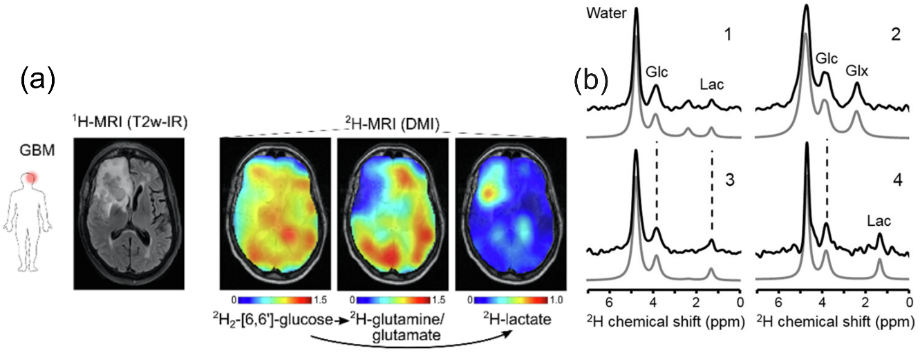
Example:
Fig 1. (a) ¹H-MRI and ²H-MRI (DMI) images of clinical glioblastoma multiforme (GBM). DMI of glucose and metabolites Glx = glutamine/glutamate and lactate. DMIs show lower levels of ²H-labeled Glx and higher concentrations of ²H-lactate in and around the tumor, reviling the active Warburg effect. Subjects orally ingested 0.6–0.75 g [6,6']-²H₂-glucose per kg body weight. (b) ²H NMR spectra from different areas reveal different metabolisms that can be well seen in (a). The analysis of such spectra using AI tools for better sensitivity is a crucial part of the project. Here, the grey spectra (1-4) were fitted to the experimental black spectra and used for color-coded images. The figure is part of the ref. De Feyter, H. M. et al. Science Advances 4, eaat7314 (2018)

Slide 4
Yeast model:
A proven model for decoding cellular pathways like glycolysis and the Krebs cycle, mirroring higher eukaryotic systems.
Saccharomyces cerevisiae's metabolism offers vital insights relevant to human biology, aiding in translational research.
Genetic flexibility ensures yeast can be easily engineered for specific metabolic functions, enhancing research versatility.
Yeast's low cost and easy availability make it an ideal candidate for extensive scientific research.
Requires only basic equipment for cultivation.
Yeast's fast metabolism facilitates quicker observations of metabolic changes and reactions.

Slide 5
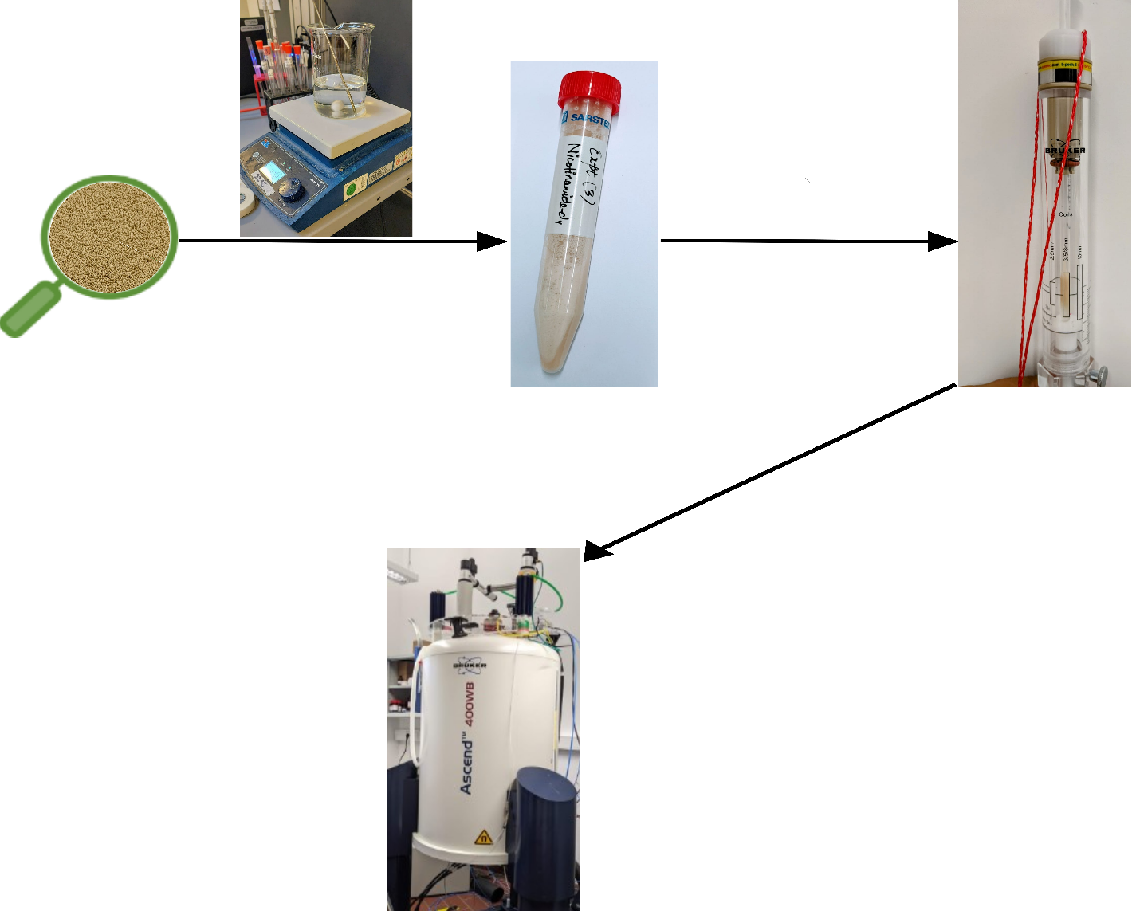
Method:
Incubation
(32⁰C ̴ 10 min)
Baker’s yeast
Yeast suspension
5 mm NMR tube assembly
with 248 µL yeast suspension
NMR Assembly
248 µL substrate
+
²H NMR spectra

Slide 6
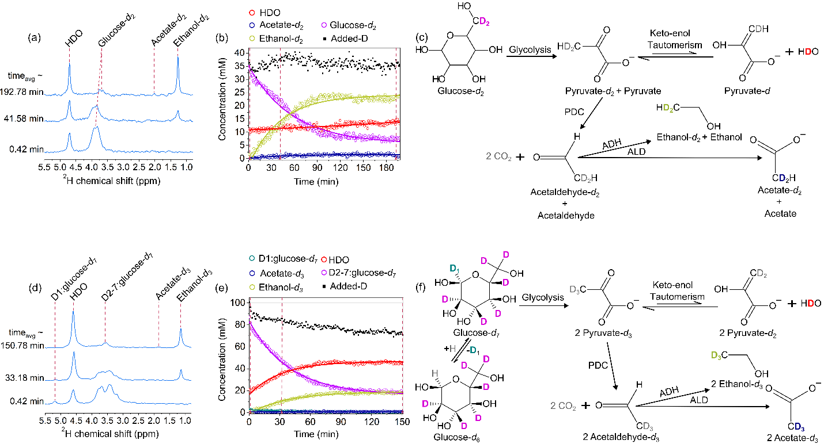
Results:
Figure 2. DMRS of Gluc-d₂ and -d₇ in yeast assay. DMRS spectra (a, d), kinetics (b, e), and schemes (c, f) demonstrate glucose (Gluc-d₂ and Gluc-d₇) metabolism to ethanol and acetate. Exchange with protons results in a loss of deuterium label and an increase in the water peak, which is more evident in case of Gluc-d₇ (d, e). Kinetics (symbols in b and e) were obtained by integrating the corresponding lines.

Slide 7
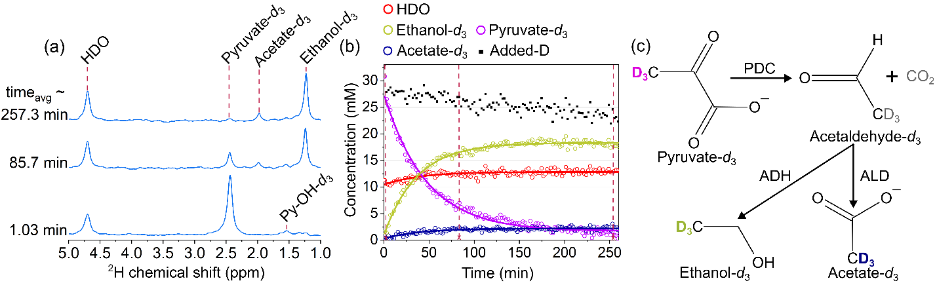
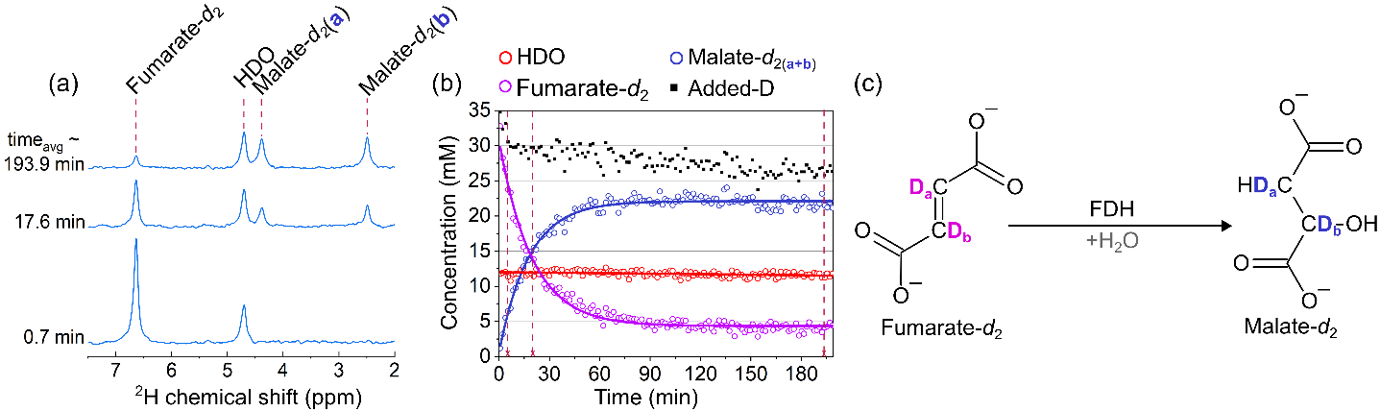
Figure 3: DMRS of Pyr-d₃ in yeast assay. DMRS spectra (a), kinetics (b), and scheme (c) demonstrate pyruvate (Pyr-d₃) metabolism to ethanol and acetate. Exchange with protons results in a loss of deuterium label and about 16% increase in the water peak (a, b). Kinetics (symbols in b) were obtained by integrating the corresponding spectral lines.
Figure 4: DMRS of Fum-d₂ in yeast assay. DMRS spectra (a), kinetics (b), and scheme (c) demonstrate fumarate (Fum-d₂) metabolism to malate. There is no visible increase in a water signal (a, b). Kinetics were obtained by integrating the corresponding spectral lines (symbols in b)

Slide 8
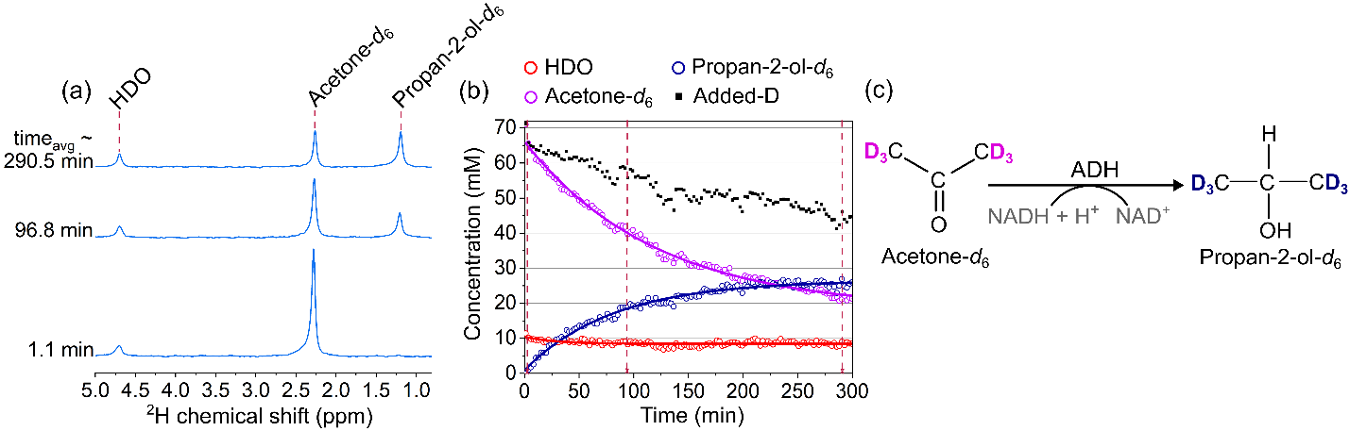
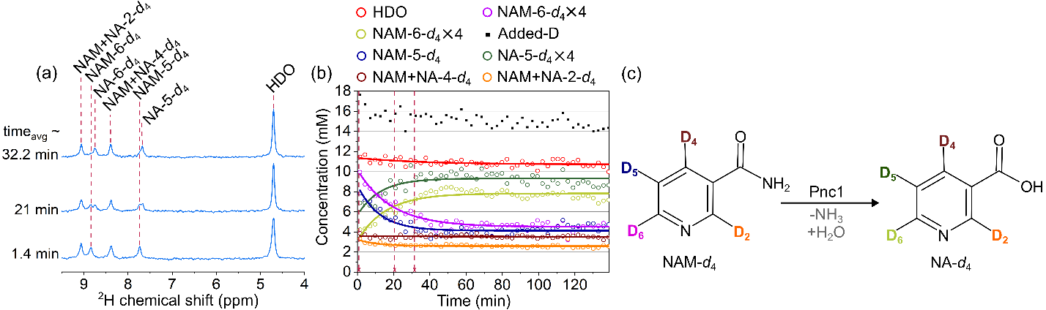
Figure 5. DMRS of Ace-d₆ in yeast assay. DMRS spectra (a) kinetics (b) and scheme (c) demonstrate Ace-d₆ metabolism to propan-2-ol. There is no visible increase in a water signal (a, b). Kinetics were obtained by integrating the corresponding spectral lines.
Figure 6. DMRS of NAM-d₄ in yeast assay. DMRS spectra (a), kinetics (b), and scheme (c) demonstrate nicotinamide (NAM-d₄) metabolism to nicotinic acid (NA-d₄). There is no visible increase in a water signal (a, b). Kinetics (symbols in b) were obtained by integrating the corresponding spectral lines

Slide 9
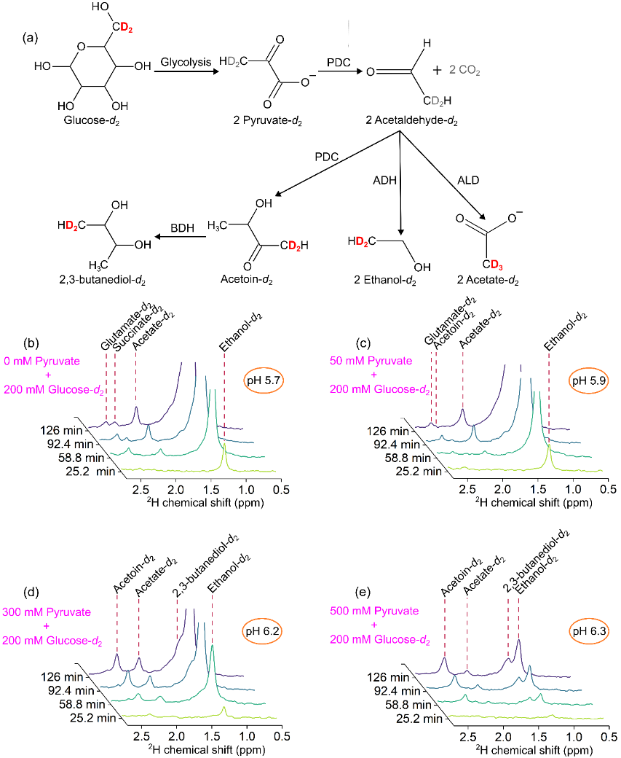
Pyruvate induced altered metabolism of glucose
Figure 7. Reaction pathway (a) and DMRS kinetics of Gluc-d₂ metabolism in yeast assay as a function of added pyruvate to the yeast media: 0 mM (b), 50 mM (c), 300 mM (d), and 500 mM (e). The addition of pyruvate decreased the production of ethanol (1.27 ppm) down to 14.2% from the initial value (from b to e), reduced the amount of acetate (1.86 ppm) and glutamate/succinate (2.47 ppm), while increased production of acetoin (2.32 ppm) and 2,3-butanediol (1.42 ppm).

Slide 10
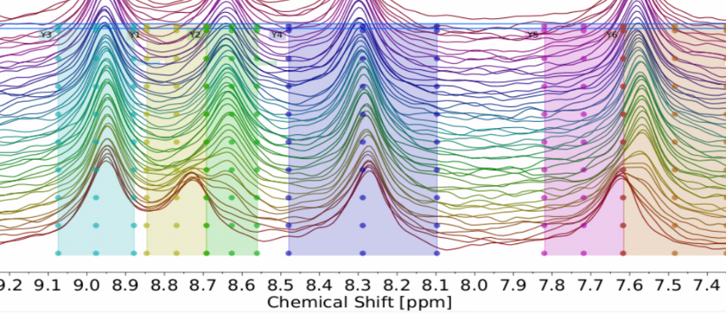
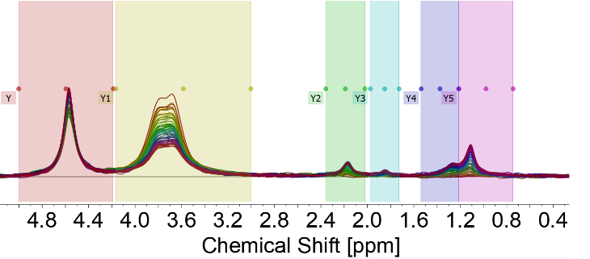
Problem in figure 5 and 6:
The kinetics (Figure 6b) were obtained from partially overlapping spectra of NAM and NA (Figure 6a) using simple integration
The kinetics, in this case were obtained from partially overlapping spectra of ethanol and 2,3-butanediol (Figure 7e) using simple integration

Slide 11
Solution for DMRS spectral analysis:
Advanced spectral fitting semi-automated techniques such as BATMAN, LCModel and DOLPHIN offer improved reproducibility and accuracy compared to manual integration.
Integration of deep-learning-based pipelines, including convolutional neural networks (CNNs) like NMRQNet which is AI based, streamlines the analysis process, offering unsupervised automatic identification and quantification of metabolite reaction rate with increased sensitivity.
Future goal:
Open source, automated metabolic data analysis tool.
We will provide you with:
(1) Metabolic data; (2) access to our bio lab if you like it; (3) support with the data analysis and metabolic models; (4) publication in a journal if the minimal viable tool is ready for use

Slide 12
Thank you!

